Slide 1
Emotional Intelligence for All

Slide 2
WELCOME

Slide 4
Who is this guy?
Stan Davis
HAP Principal/Founder
Water, Water, Water

Slide 5
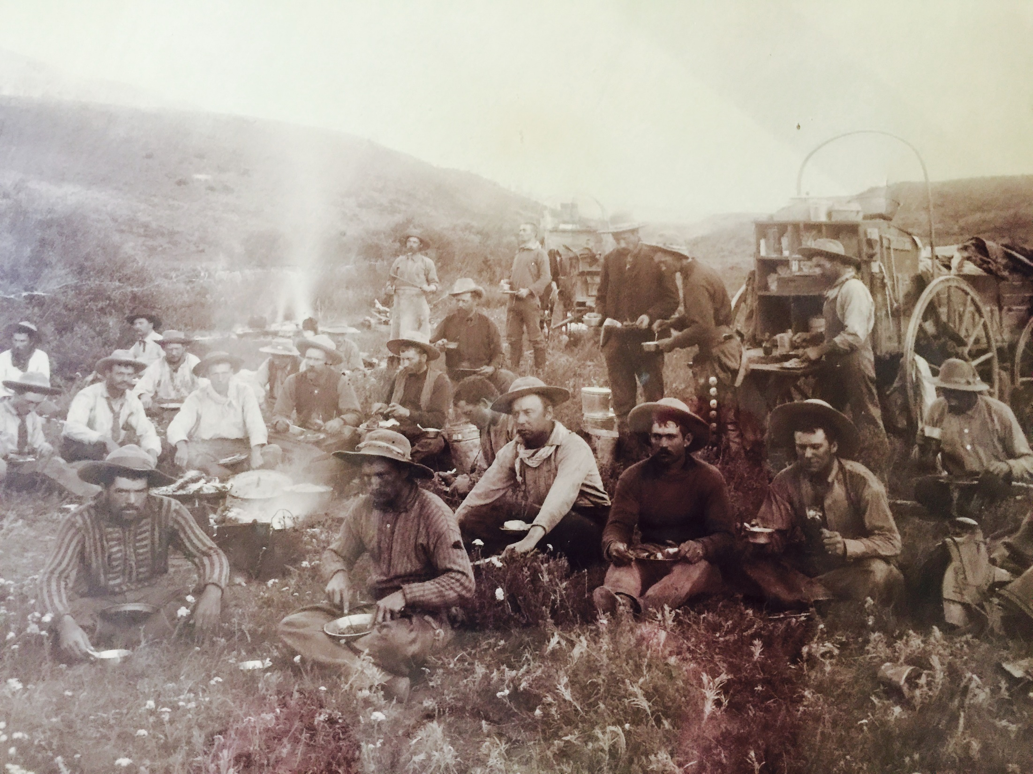

Slide 6
QM 2 US Navy

Slide 8
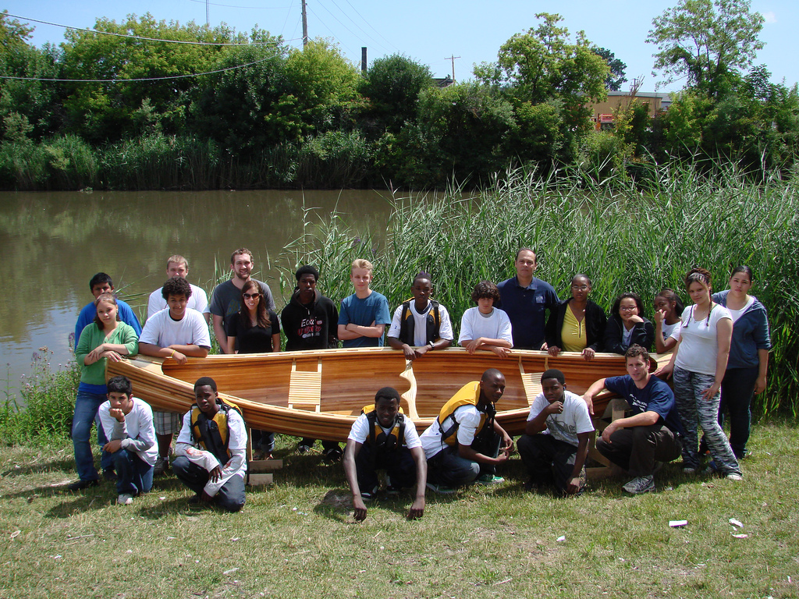

Slide 10
The Story of

Slide 11
Why Emotional Intelligence?
So we can hold hands and sing Kumbaya!
Assertive Accountability Model; this is about Doing Work & Productivity!
HBR: in the US, annual cost of inefficiencies due to incivility in the workplace:
51 Billion!

Slide 13
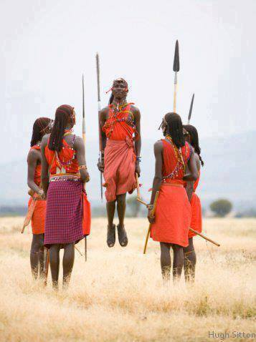
Unit 1 Culture

Slide 14
3 Aspects of Culture in HAP Theory
Who you are; we ARE our set of experiences!
What are the Cultures, Subcultures, Groups and Subgroups we walk through each day?
How do we DRIVE Culture in our Team or Organization? Why Leave it to Chance?

Slide 15
Race vs Ethnicity

Slide 16
Race vs Ethnicity

Slide 17
Unit 2 Emotional Management

Slide 19
Unit 3 Communication Awareness

Slide 20
Values
P
A
C
Critical Parent
Nurturing Parent
Adult
OK Child
Not OK Child
Rationale
Emotions

Slide 21
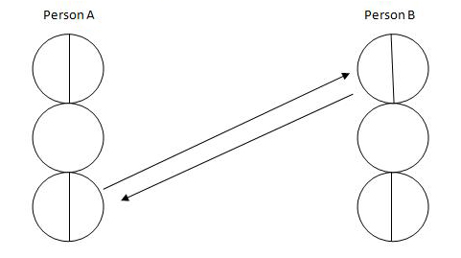
Cross Transaction

Slide 22
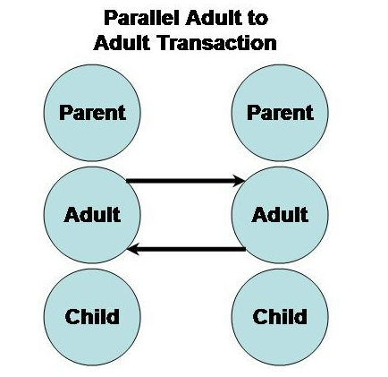

Slide 23
Unit 4 Essential Skills

Slide 24
HALT!
Hungry Angry Lonely Tired

Slide 25
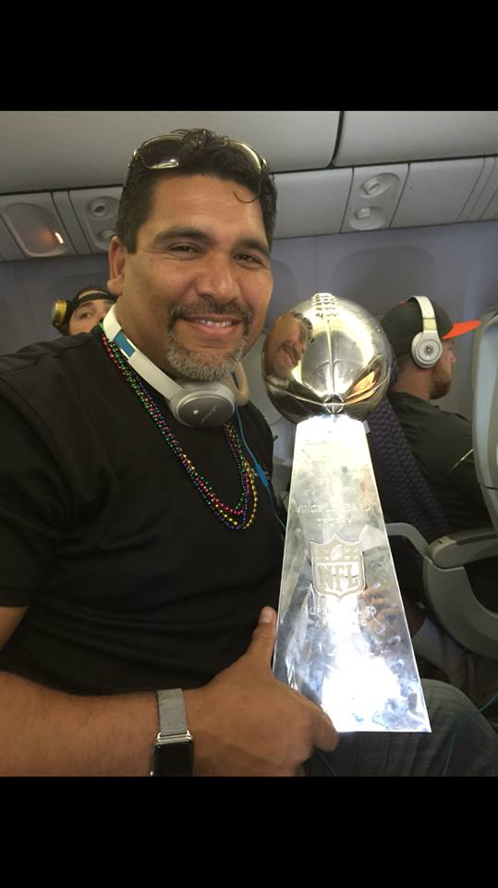

Slide 26
Three Highs
High Relationship
High Expectation
High Support

Slide 27
…don’t forget to ASC
Awareness
Skills Courage

Slide 29
Need Anything?
Call Me: 707-927-8131
Stan Davis stan@haptraining.com

Slide 30
Thank You
Thank you!

